Slide 1

New Student Center: Integration of Useful Pages and Utilizing Bootstrap
By: Ambur, Chang and Wang
Notes:
For our groups final project we redesigned UW Madison’s Student Center

Slide 2
UNDERSTANDING
Describe whom you interviewed?
3 UW undergrads
What process did you follow?
Combination of Ethnography and Think-aloud
What tasks did they do?
Check current DARS and schedule
Searched for the class
Searched information about the class
Add the class
Notes:
As students who have used Student Center for years we knew it needed many design changes. Fellow badgers also agreed; for help better understanding the problem areas of the Student Center we interviewed 3 UW students of varying age and background to get their thoughts on the website.

Slide 3
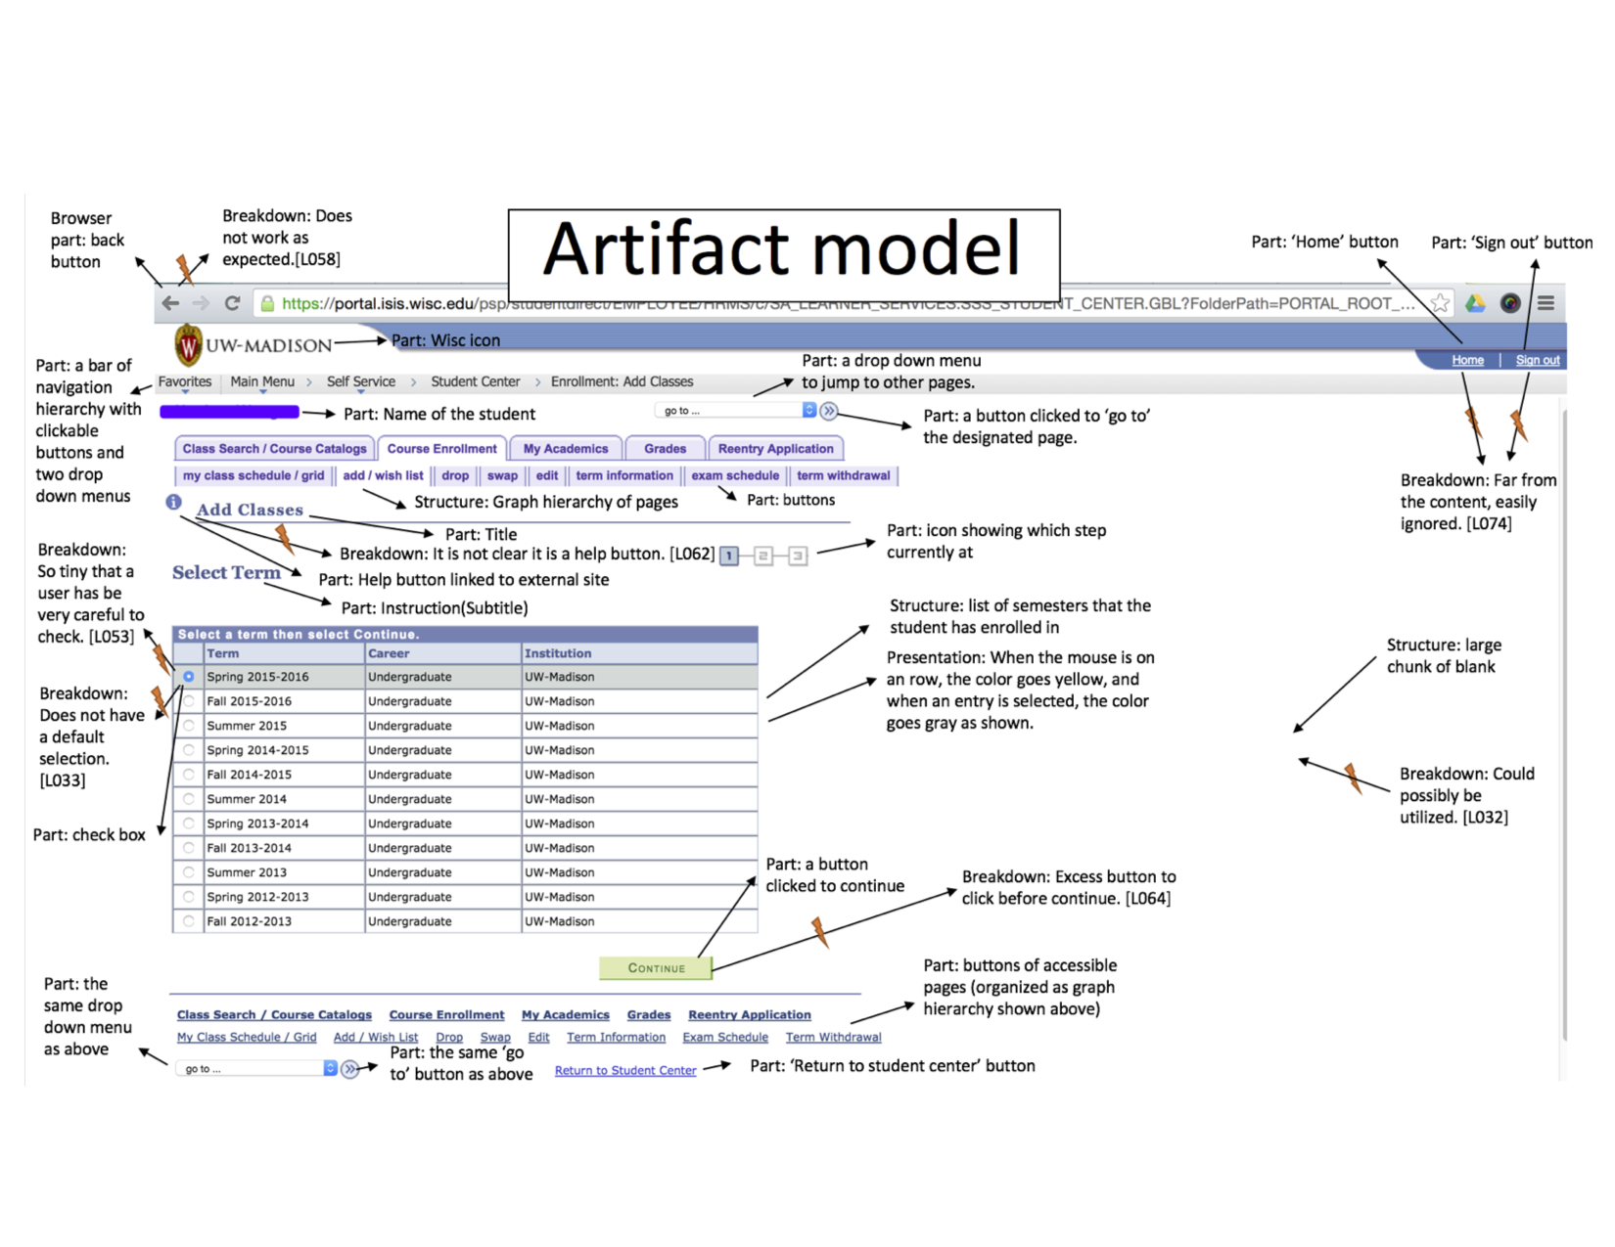
IDEATION
Breakdowns/workaround/opportunity:
Multiple clicks and
page transition
Slow
Poor search function
General layout
etc...
Notes:
After talking with students we realized there were many features that needed improvement. The amount of time it takes to add a class needs to be cut down by reducing clicks and pages. Layout and page utilization can be improved with the bootstrap framework. As well as including the many other websites that students visit for class information right into the search functionality.

Slide 4
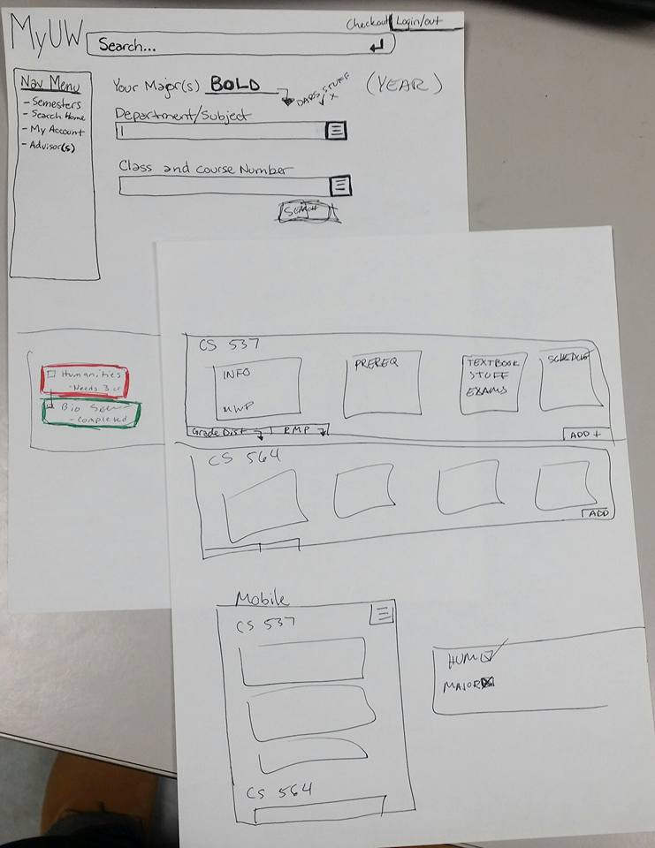
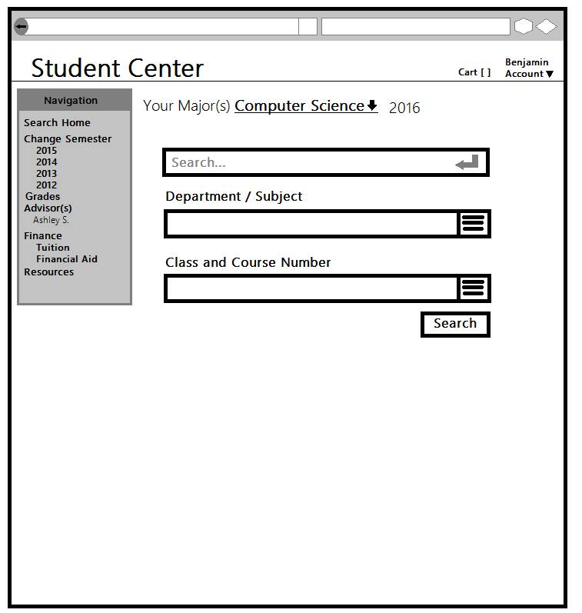
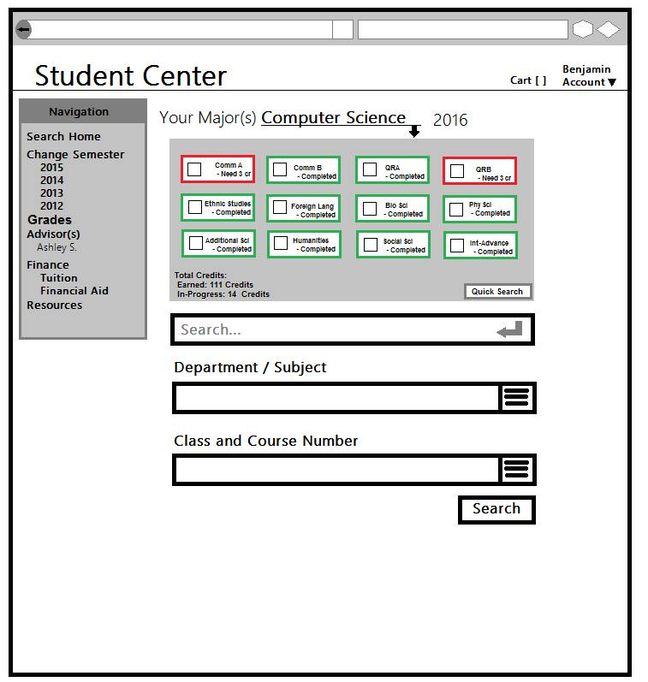
PROTOTYPING
<---- Initial Paper Prototype
Lo-Fi Prototype ---->
Notes:
When beginning our sketches and low fidelity prototypes we really wanted to focus on ease of use for the user. Creating search functions and navigation that give the student the most information in the shortest amount of time.

Slide 5
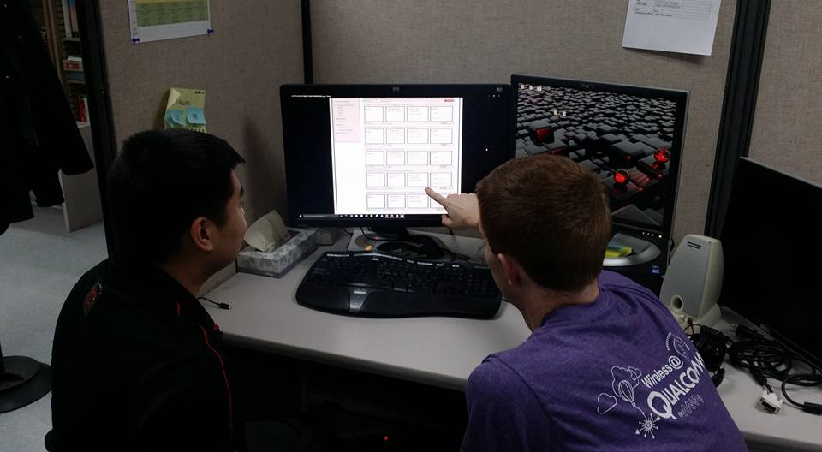
EVALUATING
Ask the users to evaluate our lo-fi prototype...
Top likes: | Top dislikes:
Side navigation bar | Click to expand class information
DARS/schedule/class status/shopping cart integration | Unrelated information
Convenient links | Search bar location
Notes:
After the Lo-Fi prototyping we performed contextual inquiries on how the interviewee would use this if it were the new Student Center. We got good feedback on things to keep and ideas of improvement for our Hi-Fi prototype.
Some ideas that all interviewees liked were the navigational menu on the left-hand side, DARS integration, and how quickly it now takes to add a class.
Some ideas the interviewees did not like were the expanding boxes of information, and too many search options.

Slide 6
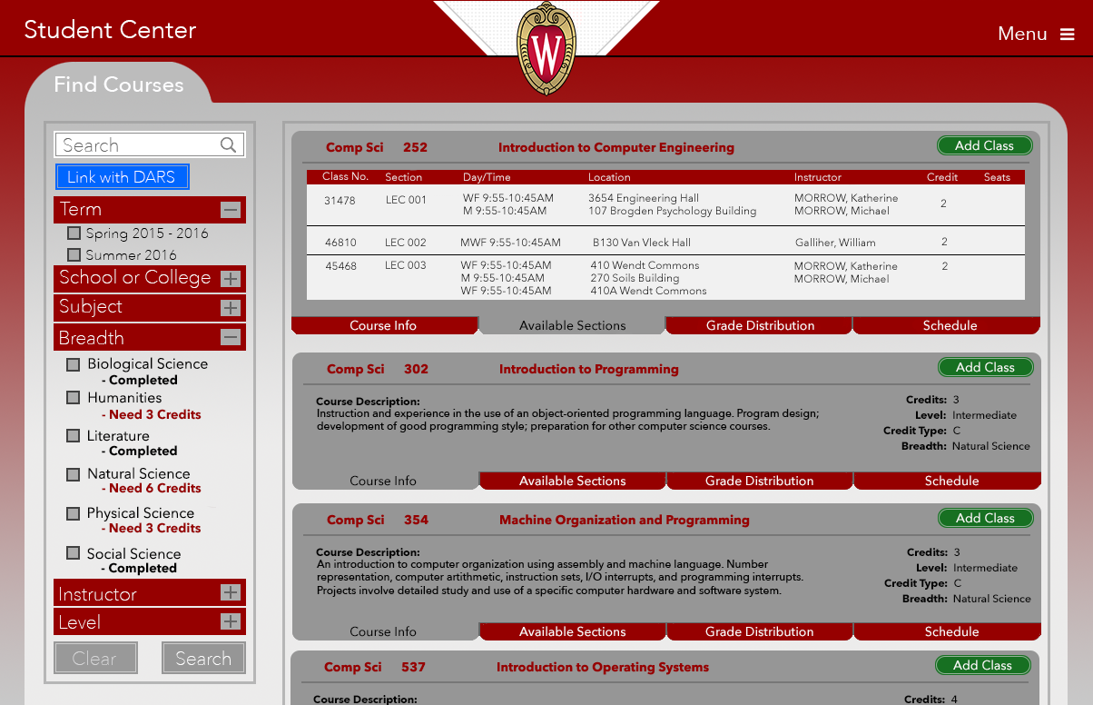
FINAL SOLUTION
Give the user a clean, organized way to find classes
Search linked with DARS report
Quickly change view to see:
Course info
Available sections
Grade distribution
Schedule
- Easily compare classes
to see what fits best
Notes:
Putting all this constructive criticism to good use we came up with our final high fidelity prototype. By clicking the blue ‘Link with DARS’ button students are able to link their class search with their DARS report to see what Breadths they have completed and how many credits they still need in others. With 4 easy to navigate tabs for each class users are able to quickly see detailed information and even see if the class fits into their current schedule. We also incorporated information from external websites like ratemyprofessor and grade distribution. Thus, Creating an organized environment to compare and add classes to your schedule.

